Slide 1











PROJECT TITLE:
HAND-GESTURE-CONTROLLED CAR WITH GPS SYSTEM AND OBJECT DETECTION
CSE 316 – MICROPROCESSORS AND MICROCONTROLLERS LAB
DEPARTMENT OF COMPUTER SCIENCE AND ENGINEERING, UNIVERSITY OF ASIA PACIFIC
P r e s e n t e d B y :
22201252(SHUHURAT FARIHA)
22201256(BIVASH NANDAN DEBNATH)
22201266(MAISHA SAMEHA)
P r e s e n t e d T o :
ZAIMA SARTAZ TAHERI LECTURER, DEPARTMENT OF CSE

Slide 2

Project Objective
The main goal of our project is to build a gesture-controlled robot that moves and operates using hand movements instead of traditional buttons or remotes.
It aims to make robot control easier, faster, and safer, especially in places where humans cannot reach — such as rescue operations, surveillance, and delivery tasks.

Slide 3
Societal Impact and Motivation
Disaster & Rescue Operations:
This robot can help rescuers reach dangerous or hard-to-access places without putting human lives at risk.
Surveillance & Security:
It can be used to monitor restricted or unsafe areas remotely, keeping people safe while maintaining security.
Smart Delivery Systems:
The robot can carry and deliver items in places like hospitals or warehouses, reducing manual effort and saving time.
Assistive Technology:
People with disabilities can use simple hand gestures to control the robot, making technology more accessible.

Slide 4

Equipment and Components
1. Gesture Controller (Transmitter):
ESP32 Dev Board (WROOM-32) – Main microcontroller that reads hand gestures and sends signals wirelessly.
MPU6050 (Accelerometer + Gyroscope) – Detects hand movement and tilt to control the car.
Li-Po Battery (3.7V) – Powers the hand controller.
TP4056 Charging Module – Safely charges the Li-Po battery. On/Off Switch – Turns the controller on and off.
LED Indicator – Shows when the controller is active or sending data.

Slide 5

Equipment and Components
2. Car (Receiver Unit) :
ESP32-CAM Module – Main controller that receives commands and drives the car motors.
FTDI USB-to-Serial Adapter – Used for uploading code to ESP32-CAM. Motor Driver (L298N / TB6612FNG) – Controls the DC motors based on ESP32-CAM input.
DC Motors with Wheels (x4) – Enables the car to move.
Battery Pack (7.4V Li-ion/Li-Po) – Powers both ESP32-CAM and motors.
Buck Converter (DC-DC Step Down) – Reduces 7.4V to 5V for safe ESP32-CAM operation.
Car Chassis – Holds all the hardware parts together.
Connecting Wires & Breadboard – For connections and easy circuit testing.

Slide 6
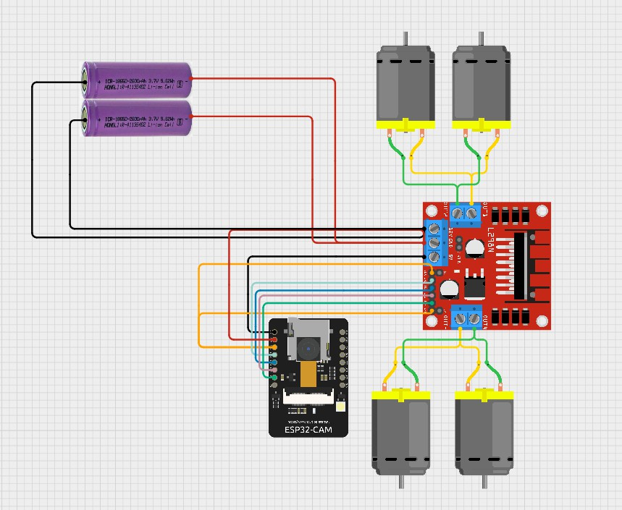
System Block Diagram

Slide 7
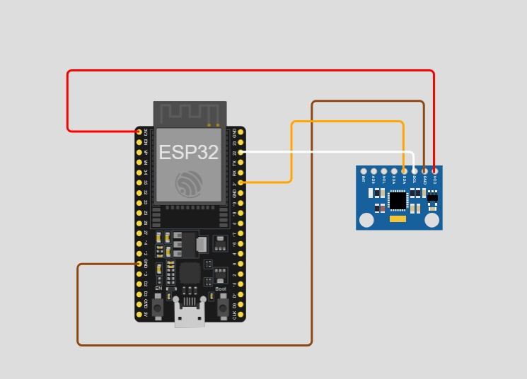
System Block Diagram

Slide 8
System Block Diagram
The project uses an ESP32 microcontroller with an MPU6050 sensor and an L298N motor driver. MPU6050 provides motion and balance data to the ESP32 through the I²C interface.
ESP32-CAM controls four DC motors using the L298N motor driver. The system is powered by 18650 Li-ion batteries.
Sensor data helps the ESP32 adjust the motors for smooth and stable movement. ESP32-CAM can also stream live video for monitoring or remote control.
The setup can be used for robot cars, self-balancing robots, or surveillance robots.

Slide 9
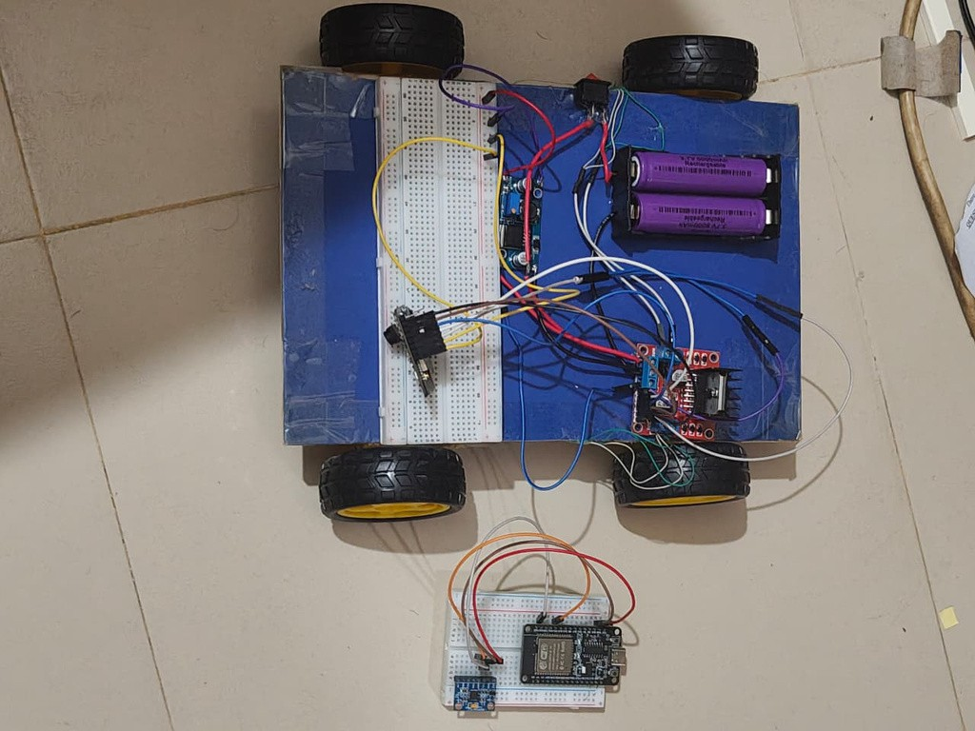

Project Implementation Image
System was tested on flat indoor surface, motion response verified for all gesture directions.

Slide 10
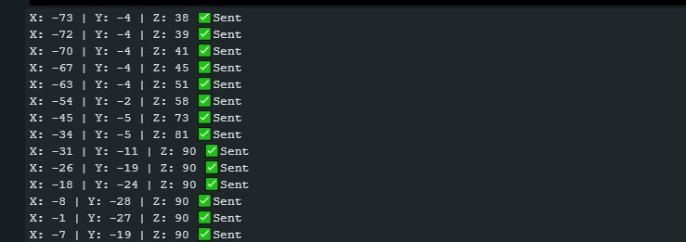
Results and Analysis
The car successfully responded to tilt-based hand gestures (forward, backward, left, right), achieving smooth and reliable motion control. The wireless communication between the ESP32 (transmitter) and ESP32-CAM (receiver) worked consistently without signal loss.
Real-time response was achieved with minimal delay (<1 second), ensuring accurate control.
Although the servo, GPS, and ultrasonic modules were not integrated due to hardware and calibration issues, the main objective developing a gesture-controlled robotic vehicle — was successfully met.

Slide 11






Team Member Contribution
Shuhurat Fariha
Connected the ESP32-CAM with the motor driver and motors.
Helped in assembling and wiring the car chassis.
Managed power connections and made sure voltage was stable for all modules. Assisted in troubleshooting movement issues and testing the gesture response. Prepared presentation slides and block diagrams for submission and demonstration.

Slide 12




Team Member Contribution
Bivas Nandan Debnath
Programmed the ESP32 Dev Board and MPU6050 to detect hand gestures and convert them into movement signals.
Coded and configured the ESP32-CAM to receive commands and control the motor driver for car movement.
Implemented wireless communication between the gesture unit and car using ESP-NOW / Wi-Fi, ensuring smooth real-time control.
Wrote and debugged movement logic for forward, backward, left, and right directions. Tested and debugged both transmitter (gesture controller) and receiver (car) for reliable performance.

Slide 13



Team Member Contribution
Maisha Sameha
Calibrated the MPU6050 sensor for more accurate hand gesture readings.
Tested the robot’s movement using different gestures and checked if responses were correct. Recorded test results and summarized how well the system worked.
Prepared project documentation for submission and demonstration.

Slide 14

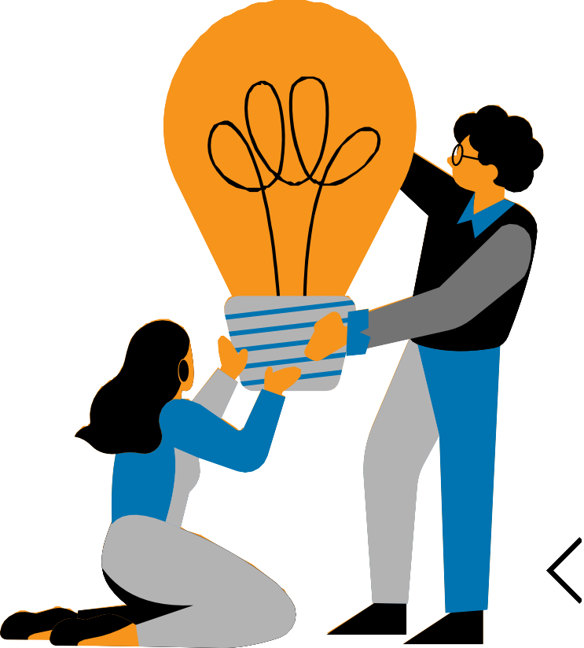
CEP Outcome Mapping
Knowledge Profile (K):
K1 – Theory-based understanding of natural sciences
→ Applied physics and electronics for sensor motion, PWM speed control, and motor driving.
K3 – Engineering fundamentals
→ Used embedded systems, circuit interfacing, and data communication principles for ESP-NOW and sensor integration.
K4 – Specialist knowledge in computing and embedded systems
→ Integrated ESP32, ESP32-CAM, and MPU6050 using wireless protocols and motion data processing.
K5 – Design knowledge
→ Designed a wireless gesture-controlled vehicle that processes sensor input and drives motors in real time.
K6 – Engineering practice knowledge
→ Implemented real-world testing, debugging, calibration, and synchronization between sender and receiver modules.
K7 – Societal and ethical awareness
→ Designed to support rescue and surveillance operations, reducing human risk and promoting safe, efficient use of technology.

Slide 15

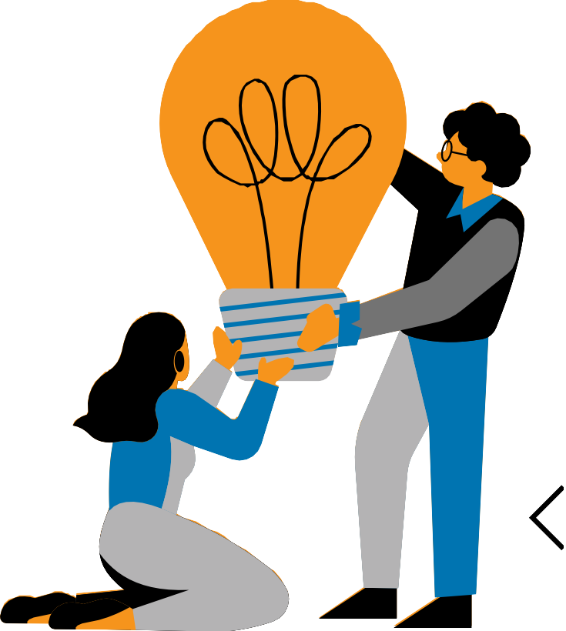
CEP Outcome Mapping
Complex Engineering Problem (P):
P1 – Depth of Knowledge Required:
→Requires understanding of motion sensors, microcontrollers, real-time signal transmission, and IoT-based
communication (ESP-NOW).
P2 – Conflicting Requirements:
→Balancing system response speed, stability, range, and power consumption while maintaining accuracy.
P3 – Depth of Analysis Required:
→Processes continuous motion data (yaw, pitch, roll) and converts it into real-time control signals for motor movement.
P6 – Stakeholder Involvement:
→Serves rescue workers, security teams, and students learning advanced robotics.
P7 – Interdependence:
→Gesture detection, ESP-NOW transmission, and motor control all depend on one another to function correctly.

Slide 16

CEP Outcome Mapping
Complex Engineering Activities (A):
A1 – Range Of resources:
→Used multiple components — MPU6050, ESP32, ESP32-CAM, L298N motor driver, DC motors, and power supply modules.
A2 – Interaction among systems:
→Gesture (input), wireless (transmission), and motor (output) systems communicate and operate in real time.
A4 – Societal and Environmental Consequences:
→ Helps rescuers operate safely in hazardous areas, supports people with disabilities, and data and camera use in surveillance are handled responsibly to protect privacy and prevent misuse.

Slide 17


Conclusion
We successfully built and tested a gesture-controlled car using ESP32-CAM and MPU6050.
The car moved correctly based on hand tilts, showing smooth and real-time control. Some parts like GPS, servo, and sensors could not be added because of hardware and coding issues.
In the future, we plan to include GPS tracking, object detection, and better stability to make the system
more advanced and useful.

Slide 18

References
ESP32-WROOM-32 30-pin configuration: https://esp32.com/viewtopic.php?t=9875 ESP32 with NEO-6M GPS Module: https://randomnerdtutorials.com/esp32-neo-6m- gps-module-arduino/
Setting up ESP32 CAM: https://randomnerdtutorials.com/program-upload-code- esp32-cam/
ESP32 with MPU6050: https://randomnerdtutorials.com/esp32-mpu-6050- accelerometer-gyroscope-arduino/
YouTube tutorials on ESP32-based hand-gesture-controlled cars and obstacle- avoiding robots, and ESP32 CAM cars with object recognition.

Slide 19








THANK YOU

